Slide 1
Insurance Branch Analytics Dashboard
Reviewing Business Performance

Slide 2




Insurance Analytics Tools
Excel
MySQL
PowerBI
Tableau

Slide 3






Presentation Agenda
Project Context & Objectives
Data Architecture & Schema
Overview of insurance branch goals and performance focus.
Data Source database structuring.
Core KPIs & Metrics
Dashboard Walkthrough
Tracking new business growth, renewals, and conversion rates.
Interactive demonstration of branch analytics and filters.
Key Insights & Takeaways
Strategic Recommendations
Critical findings derived from performance trends.
Actionable next steps to optimize branch operations.

Slide 4

Project Context & Objectives
Is to establish Insurance Branch Analytics Dashboard to monitor, evaluate, and enhance branch operational performance.
Core Objectives
Track Key Performance Indicators (KPIs)
Measure essential operational metrics focusing specifically on new business acquisition and policy renewal success rates
Drive Data-Driven Decision Making
Translate complex branch datasets into clear, actionable insights to optimize resource allocation and daily operations.
Align with Strategic Goals
Empower branch leadership to identify growth opportunities, minimize churn, and achieve overarching organizational targets.

Slide 5

Data Architecture & Schema
Core Policy, Claim, and Customer Information Schema
Customer Master Data
Centralized repository containing customer demographic details, contact information, occupation etc
Policy Administration Details
Comprehensive records of active policies, including policy numbers, coverage limits, effective dates,
premium amounts, and renewal or lapse status.
Insurance Type & Line of Business
Categorization of policies by product lines (Life, Health, Property or Auto).
Claims History & Management
Tracks all reported claims, including claim amount, settlement payouts,
Billing & Financial Transactions
Records payment amount, payment method, payment status, paid date etc

Slide 6
Core KPI & Metrics Overview
The Insurance Branch Analytics Dashboard delivers a comprehensive view of branch performance, with dedicated focus on new business acquisition and policy renewal metrics.
Track Insurance Targets
Monitor real-time progress towards sales goals to quickly identify growth opportunities.
Analyse Policyholder Behaviour
Gain deep visibility into customer preferences and risk profiles to tailor insurance products effectively.
Optimize Operations
Streamline branch resource allocation and elevate overall administrative efficiency.
Drive Strategic Growth
Leverage data-driven insights to elevate branch performance and achieve overarching organizational objectives.

Slide 7

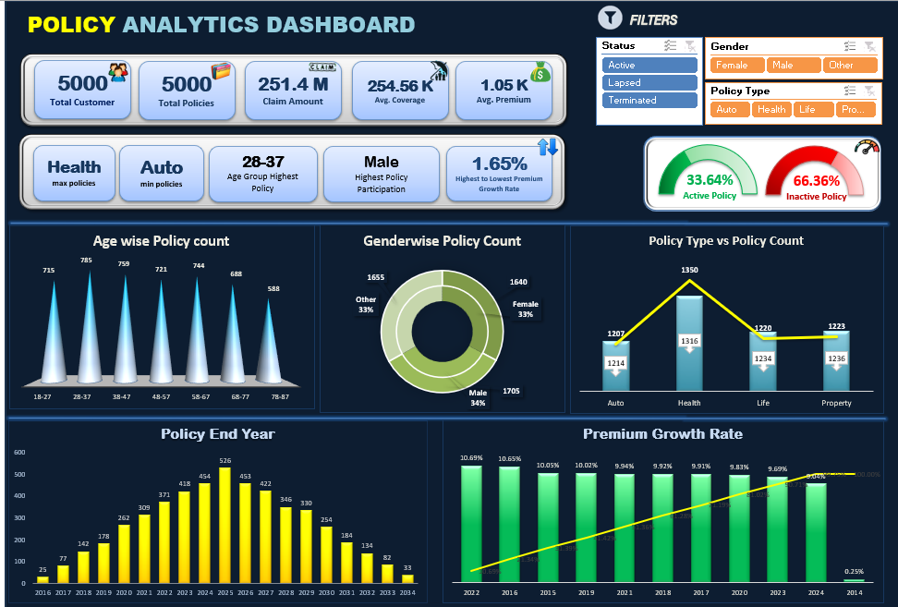
Branch Dashboard Walkthrough

Slide 8
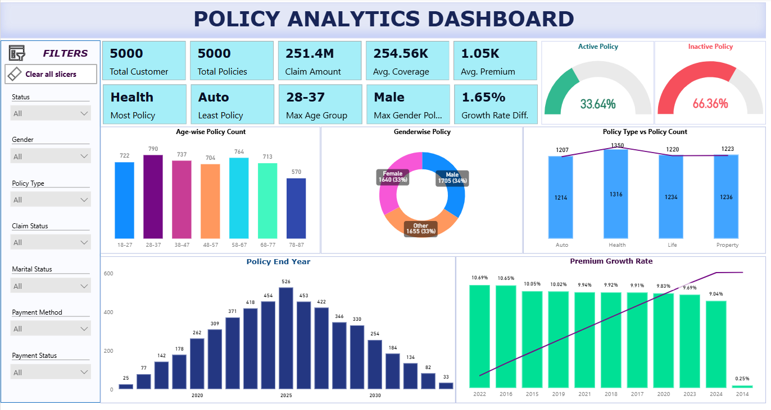
Branch Dashboard Overview

Slide 9

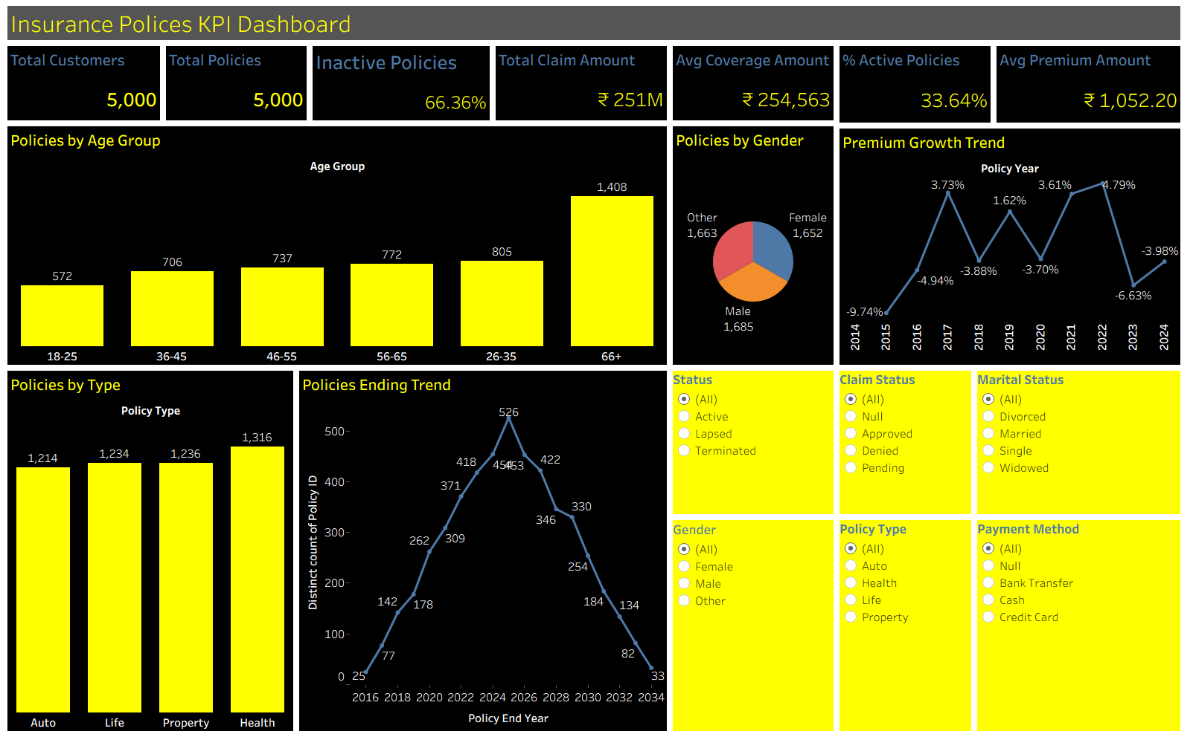
Branch Dashboard Overview

Slide 10

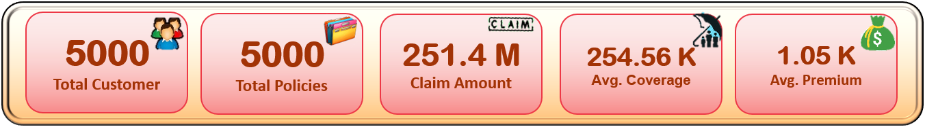
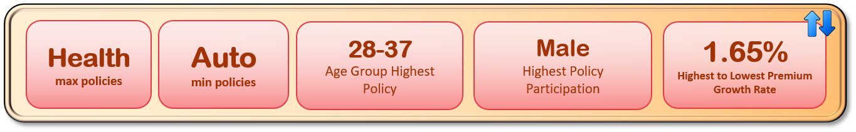
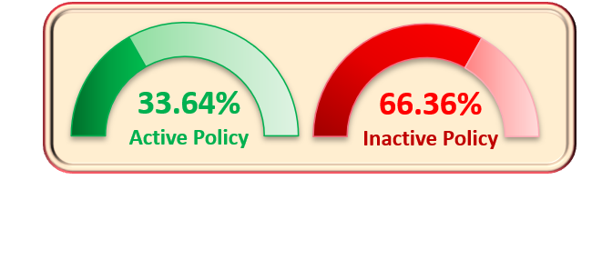
Key Performance Indicators (KPIs)
KPI Summary
Portfolio Scale
Managing a base of 5,000 customers holding an equal total of 5,000 policies (driven primarily by Health as max policies and Auto as min policies).
Demographic Concentration
Core policy participation is heavily anchored by the 28–37 age group and Male demographics.
Financial Risk & Liability
Total claim liabilities stand significantly high at $251.4M with 66.36% of Inactive policies, balanced against an average coverage of $254.56K and an average premium yield of $1.05K
Financial Growth Trajectory
Premium growth rate is currently tracking at a modest 1.65% (highest to lowest).

Slide 11

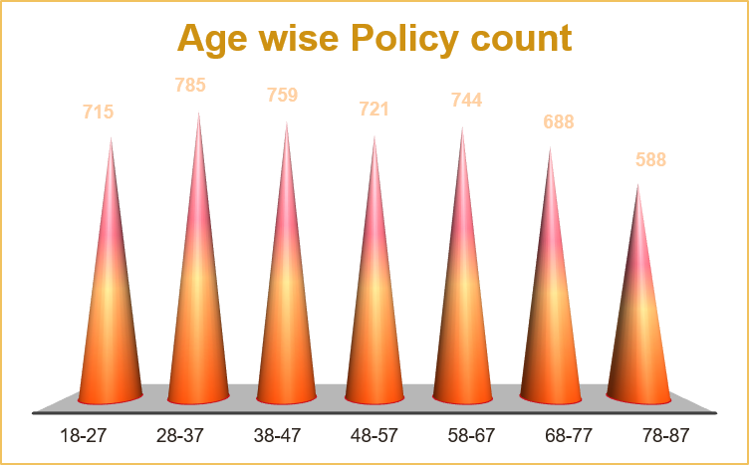
Key Performance Indicators (KPIs)
Summary
Age-Wise Policy Distribution:
Peak policy adoption is concentrated in the 28–37 age group (785 policies) and 38–47 age group (759 policies), while the 78–87 age group records the lowest count (588 policies).
Gender-Wise Policy Distribution:
Policy distribution is evenly balanced across genders, with Male leading slightly at 34% (1,705 policies), followed closely by Female at 33% (1,640 policies) and Other at 33% (1,655 policies).
Policy Type vs. Policy Count:
Health policies record the highest volume with 1,316 count, whereas Auto records the lowest count at 1,214, alongside Life (1,234) and Property (1,236).

Slide 12
Key Performance Indicators (KPIs)
Summary
Policy Maturity & Expiration:
The Policy End Year analysis highlights a multi-year maturity cycle, showing a steady rise in expirations that peaks notably in 2025 at 526 policies before gradually declining through 2034.
Premium Expansion Performance
Peak growth years like 2022 (10.69%) and 2016 (10.65%) at the forefront. Even though there is regular up and down in the performance, the difference in highest to lowest growth rate stands at 1.65% which shows the consistency or balanced premium rate

Slide 13


Key Insights & Takeaways
Strengths
Robust Portfolio Scale:
Solid customer base of 5,000 customers maintaining a balanced 1:1 policy-to-customer ratio.
Core Demographic Engagement:
Mid-age adults (28–37) demonstrate strong and consistent interest across our overall insurance offerings.
Leading Buyer Segment:
Male clients represent the highest volume of insurance policy buyers.
Consistent Financial Yield:
Premium growth rate has maintained stability across the operational years.
Top-Performing Product:
Health insurance stands out as our most-selling product category.
High Engagement Segment:
Female policyholders maintain the highest proportion of active policies.
Weaknesses
High Inactivity Rate:
Inactive policies account for a significantly high portion of the portfolio at approximately 66%.
Financial Strain & Declining Premiums:
Premium paid amounts are decreasing over the years while the company simultaneously faces a heavy burden to settle claims for active policies.
Disengaged Buyer Segment:
Despite registering the highest volume of policies, male clients also account for a disproportionately higher number of inactive policies.
Post-2025 Expiration Decline:
Policy expiration and maturity rates show a notable downward trend following the year 2025.
Stagnant Policy Expansion:
Overall policy and premium growth experiences a declining trend following the year 2022.
Outdated Transaction Preferences:
Cash remains the primary payment method utilized for policies, posing efficiency and operational challenges.

Slide 14

Strategic Recommendations
Increase Productivity
Modernize Payment Processing:
Transition operations away from the high preference for cash payments by introducing automated digital gateways, mobile wallet solutions, and instant bank transfers to reduce administrative overhead and manual reconciliation friction.
Automate Policy Lifecycle Management:
Streamline backend workflows to tackle the steep decline in policy end years and prevent processing bottlenecks around the 2025 expiration spike.
Optimize Resource Allocation:
Direct sales and customer support teams to focus efforts on underperforming segments.
2. Strengthen Client Relationships
Targeted Engagement for Inactive Policyholders:
Since policyholders show a higher rate of inactivity, deploy tailored re-engagement campaigns, loyalty perks, and personalized check-ins to win back disengaged clients.
Enhance Digital Touchpoints:
Roll out user-friendly self-service client portals that facilitate smooth communication and effortless digital policy management.
Age-Specific Value Propositions:
Build tailored communication channels for customers outside the peak 28–37 range to cultivate long-term brand loyalty across all age policy holders.
3. Expand Cross-Selling
Leverage Top-Selling Health Products:
Use the high volume of Health policy buyers as an entry point to cross-sell underrepresented lines like Auto, Life, and Property protection.
Bundle Underperforming Coverages:
Package lower-selling products (such as Auto policies) with top-performing Health policies at attractive rates to increase overall product penetration per customer.
Segment-Based Cross-Sell Campaigns:
Target male and 28–37 demographic segments with bundled multi-policy offers since they form the primary active customer baseline.

Slide 15
Strategic Recommendations
4. Grow New Business
Diversify Demographic Acquisition:
Develop tailored marketing campaigns to capture market share outside the dominant 28–37 age bracket and balance the gender acquisition funnel.
Revamp Growth Strategies Post-2022:
Address the stagnation in premium growth rates following 2022 by introducing competitive pricing structures and modern insurance products.
Incentivize Digital-First Acquisition:
Attract new, tech-savvy policy buyers by promoting frictionless digital onboarding and preferred payment methods.
5. Maximize Client Retention
Address the 66.36% Inactivity Gap:
Implement aggressive retention and policy-rescue workflows to convert the massive pool of inactive policies into active, revenue-generating accounts.
Mitigate 2025 Expiration Churn:
Proactively target policies nearing their end year starting in 2025 through early renewal incentives, premium discounts, and policy reviews.
Re-engage Disengaged Male Demographics:
Create specialized retention initiatives focused on male policyholders who exhibit higher rates of policy abandonment.
6. Refine Sales Funnel
Overhaul Conversion Strategies for Non-Core Ages:
Redesign the top of the funnel for age groups outside 28–37 by adapting product features, messaging, and pricing to better fit their unique life stages.
Frictionless Payment Integration at Checkout:
Eliminate drop-offs in the sales funnel caused by outdated payment constraints by phasing out heavy reliance on cash and embedding instant digital payment options.
Re-align Product Positioning:
Focus marketing visibility on Health policies (the highest seller) while actively optimizing the conversion path for lagging products like Auto to balance portfolio distribution.

